Slide 1

22CS3511
Digital Image Processing Mini Project
Car Number Plate Detection using Matlab
KRUTHIKA B N – ENG22CS0084
By:

Slide 2
Introduction
Car number plate detection is a significant application in the field of image processing . This project focuses on developing an efficient system for automatically detecting and recognizing vehicle number plates using Matlab.
The ability to identify vehicles based on their number plates has become crucial in various domains,
including traffic management, law enforcement, and automated parking systems.

Slide 3
Objective
The primary objective of this project is to design and implement a system capable of automatically detecting and recognizing vehicle number plates using MATLAB. This involves the integration of image processing and character recognition techniques to achieve accurate and efficient results.
Specific Objectives
Image Processing
Character Segmentation
Character Recognition
Automatic Number Plate Localization

Slide 4
Problem Statement
Developing an automated system using MATLAB for detecting and recognizing car number plates in images or video streams. The system must address challenges such as variations in plate design, environmental conditions, and image noise, providing accurate and reliable results suitable for real- world applications.

Slide 5
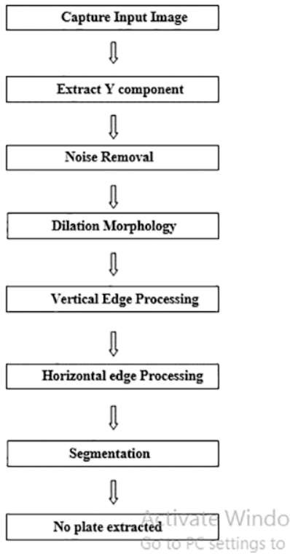
Flow Chart

Slide 6
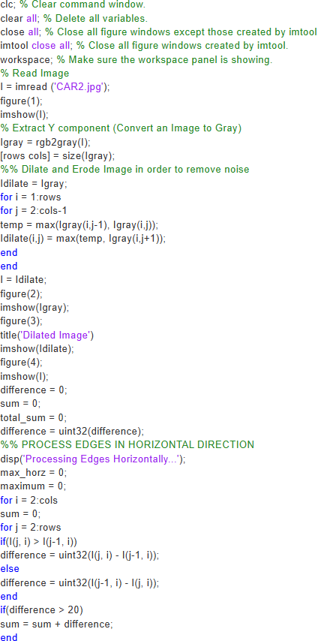
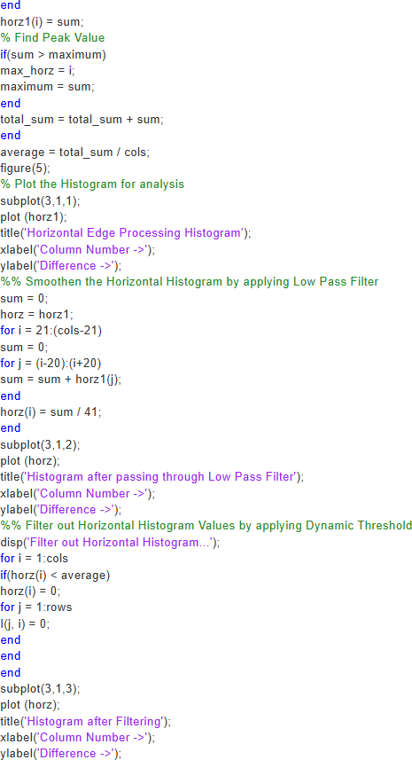
Implementation

Slide 7
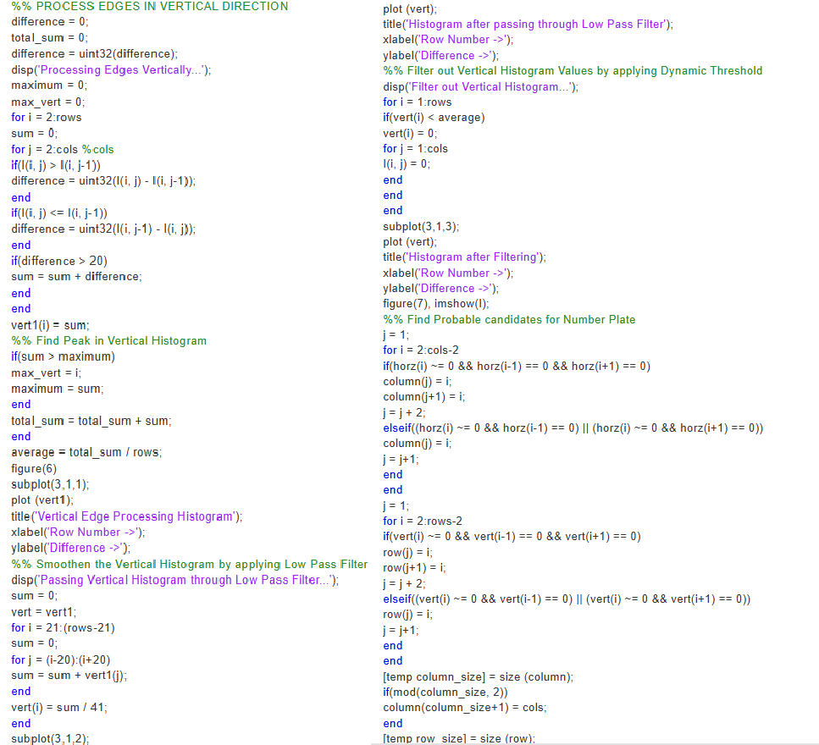
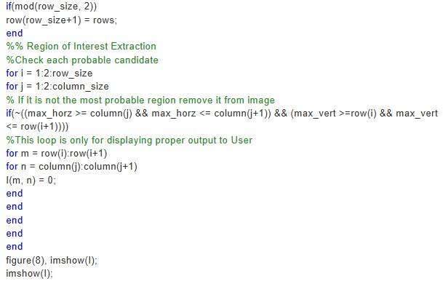

Slide 8
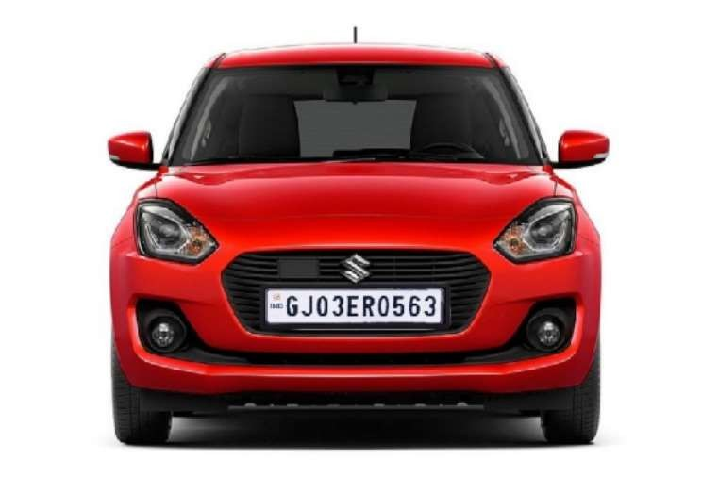
Input image

Slide 9
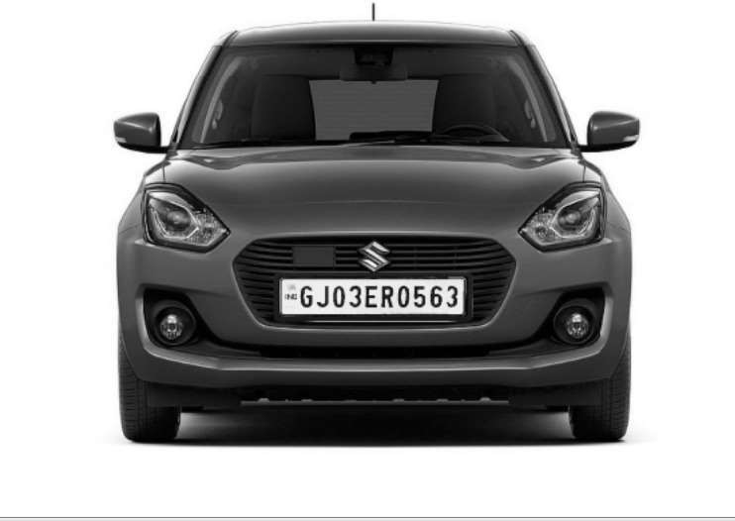
Converting a Colored Image into Gray Image
Color Independence
No Usage of RGB Components
Conversion to Grayscale
Input Image Transformation

Slide 10
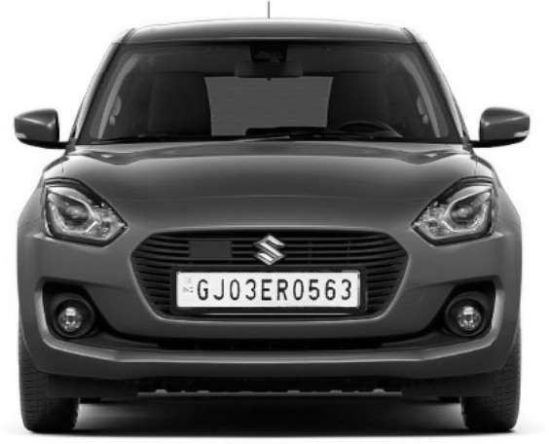
Dilation in Image Processing
Noise Removal
Edge Enhancement

Slide 11
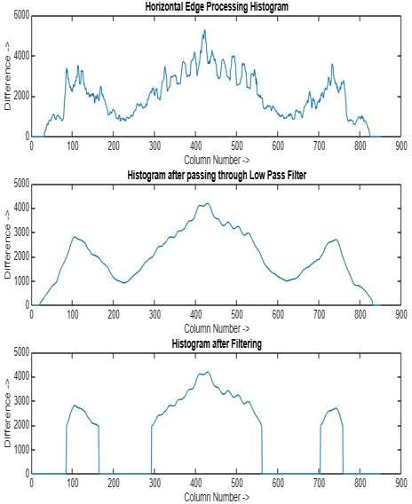
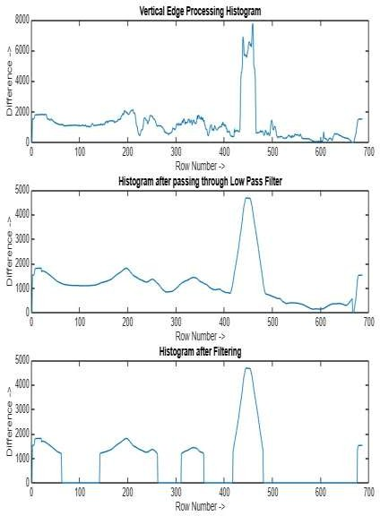
Horizontal and Vertical Edge Processing of an Image

Slide 12
Passing Histograms through a Low Pass Digital Filter.
Apply a low-pass digital filter to smooth out these changes.
Average each histogram value with its neighboring values (left and right).
Performed on both horizontal and vertical histograms.

Slide 13
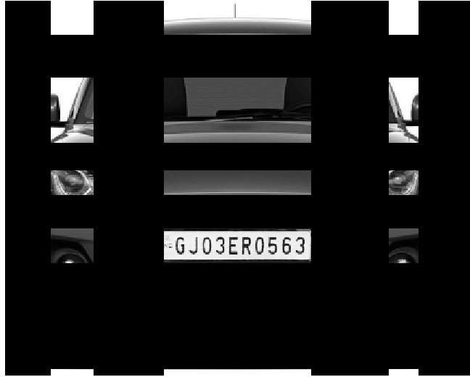
Segmentation
Find all the regions in an image that has high
probability of containing a license plate.
Co-ordinates of all such probable regions are
stored in an array

Slide 14

Output
The output image displaying the probable
license plate regions is shown.
Region of Interest Extraction
Final Region

Slide 15
Conclusion
This project successfully automates car number plate detection using MATLAB's image processing tools, addressing challenges like noise and design variability. It enables efficient, accurate plate identification for applications in traffic management, law enforcement, and smart systems. Future enhancements, such as deep learning integration, can further improve scalability and real-time performance.

Slide 16
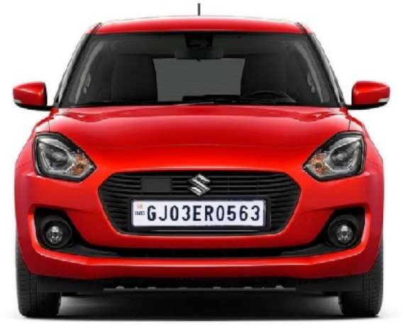

Slide 17


